Slide 1
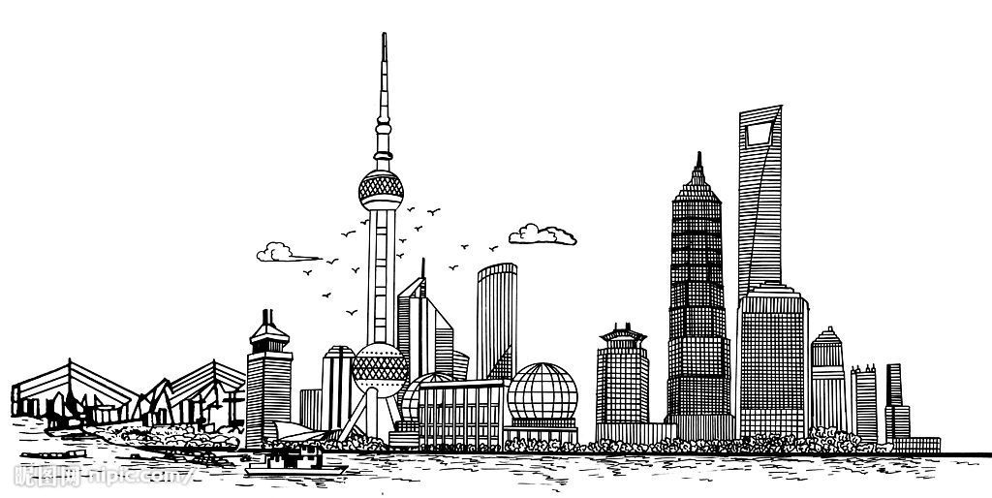
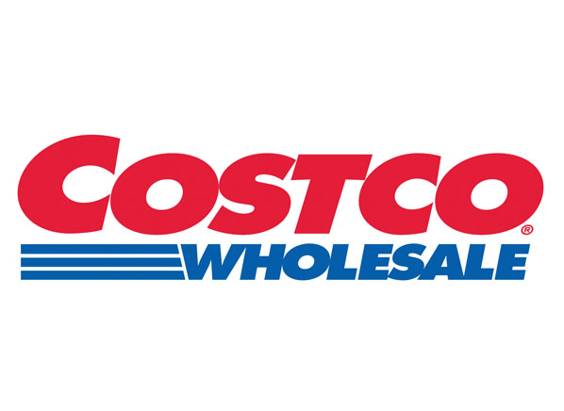
Shanghai
Team members:
Rujin(Amy) Zhang
Siqi(Lizzie) Sun
Xiwang Shen
Huangjie Zhao
Yichen(Viva) Zhang

Slide 2
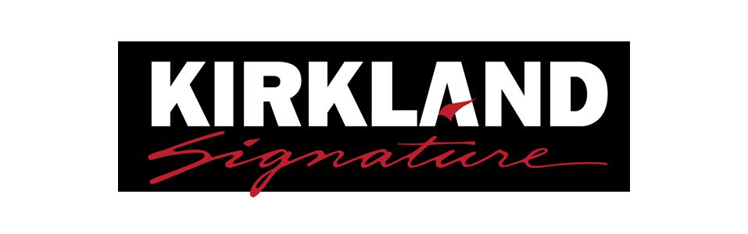
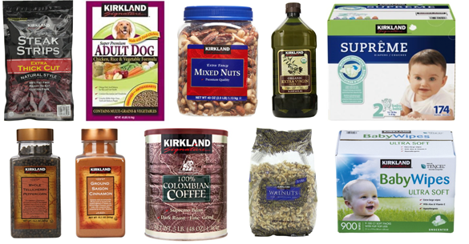
Background
Costco has 746 warehouses, worldwide (as of 09/01/2017):
518 in 44 states in the United States and Puerto Rico, 98 in Canada, 37 in Mexico, 28 in the United Kingdom, 26 in Japan, 13 in Taiwan, 13 in South Korea…
Business Model:
Sell products at low prices, high volume
Carries only 4,000 distinct products
Own house brand: Kirkland Signature
Membership only
-Wikipedia

Slide 3
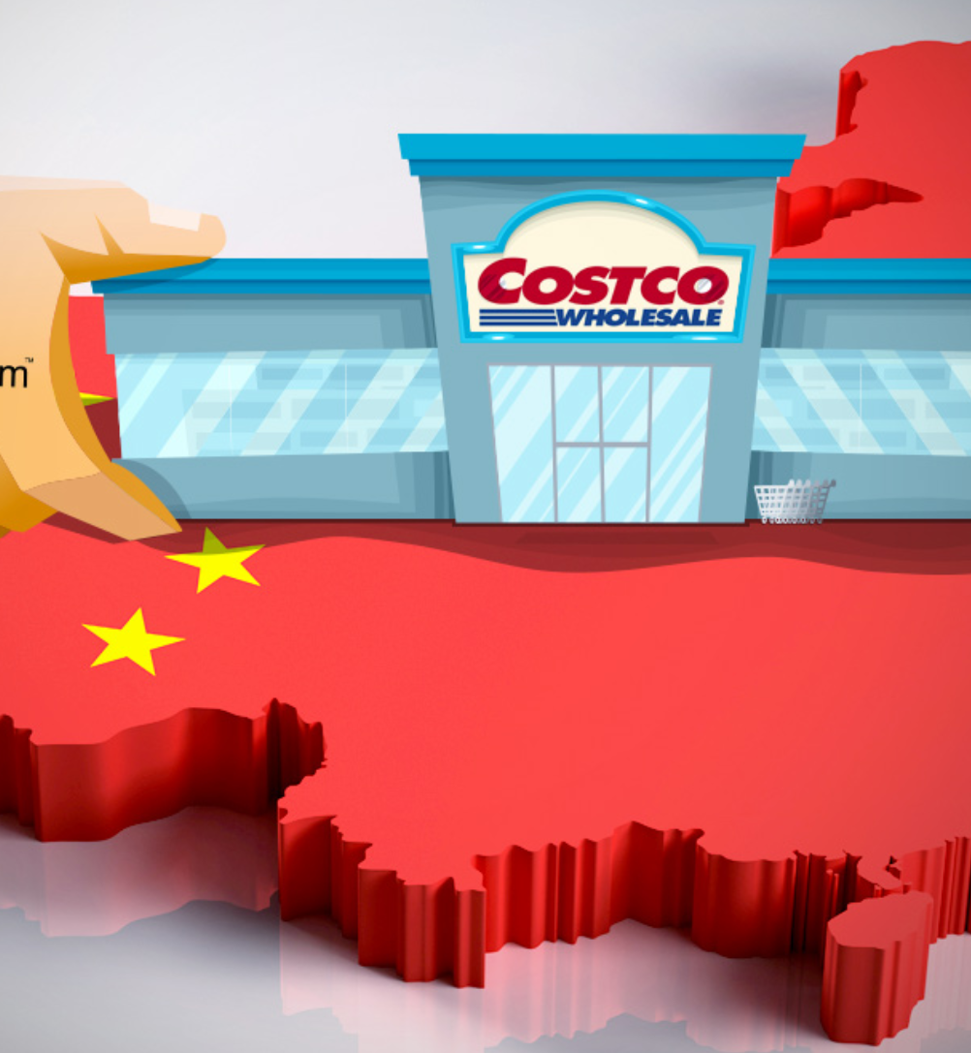
Entering Chinese Market
Online Store on Tmall Global Platform
– 0ctober 2014
Challenges:
Location Selection
Pricing
Positioning
Quality Leader
Price Leader
Customer Orientation
Brand Equity Leader

Slide 4
Solutions
4 Positioning Strategies:
Product Quality Leader: 1.75
Proprietary Brand, Package Size, Variety, Quality
Price Leader:1.67
Location, Pakage Size, Bargaining Power
Customer Orientation: 2.17
Warranty, Foretaste, Return Service, SKU Products, Membership Service, Cash Back
Brand Equity Leader: 2
Reputation
3 Judgement Bases:
Competitors
Sam’s Club
Metro
Alibaba
Target Customers
Cost
Evaluation Matrix:

Slide 5
Action Plan
Content
Management
Time Line
Calculation
Risk Effects
Communication
Pre-opening Advertising (2019.6-2019.9)
Local resident community
Local small businesses
One-stop Services
Car services and implement a service reservation app
Extend business hours
Understanding Consumer Buying Preference
Research on local stores
Corporation with Chinese vendors
Sample Calculation:

